Slide 1
Using Machine Learning to Predict Loan Defaulters
Created by Kevin Sandoval for the WGU Capstone Project

Slide 2

My Background
Born in Silver Spring, MD but grew up in San Diego, CA
Obtained Bachelors Degree in Mathematics and Statistics from University of California, Santa Barbara
Huge baseball fan with special love for the San Diego Padres
Love spending time with my girlfriend and our two cats*
Currently obtaining my Masters Degree in Data Analytics with an emphasis in Data Science
*Freya(left) and Juno(right)

Slide 3
The Problem
The problem we are attempting to solve is can we predict if a customer will default on their loans based on certain characteristics of each customer
The dataset contains unique customer related information, such as age, gender, or income
The dataset also contains unique customer information related to the company such as loan type, loan amount, and interest rate
The Hypothesis
My hypothesis is there will be variables that, when used in a Random Forest Classifier model, will effectively predict loan defaulters.

Slide 4
The Data Analysis Process
Step 1: Preparing The Data
Checking for duplicates and missing values and treat the missing values found
Check for outliers and treat as needed
One-hot encode the categorical variables
Check for highly correlated variables
Drop unnecessary and non-beneficial columns
Export the new dataframe
Step 2: Analyzing The Data
Create training, validation, and test set splits
Create model using Random Forest Classifier
Evaluate feature importance and model effectiveness

Slide 5
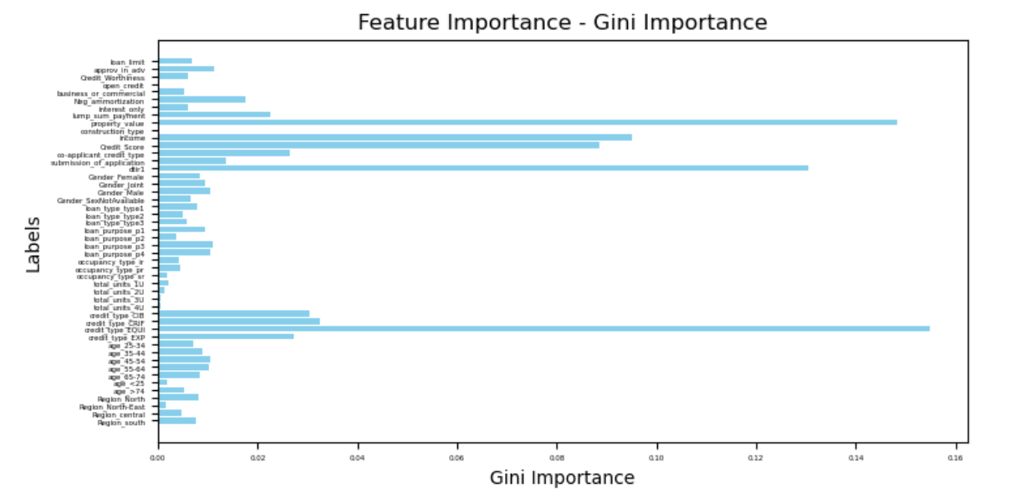
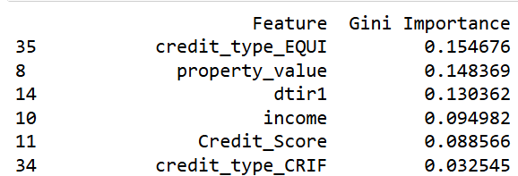
The Results
The model was found to be around 86% accurate in predicting if a customer would default
Performed better at predicting non-defaulters
5 explanatory variables stood above the rest in terms of Gini Importance
Credit_type_EQUI
Property_value
Dtir1
Income
Credit_Score

Slide 6
Techniques and Limitations
Techniques:
Dropped and imputed missing values and outliers
Used histograms, boxplots, and heatmaps for visualizations
One-hot encoded the categorical variables
Used the Random Forest Classifier for the model construction
Their Limitations:
Dropping can reduce data quantity, and imputing can reduce quality
Helpful for context, but can be misleading if not properly labeled and understood
Makes it much harder to understand what a column represents
Can only take 0 and 1 as a response for categorical variables, so we must one-hot encode. It is robust but can suffer from a lack of good-quality data

Slide 7
Proposed Actions
I recommend using this model to help predict customers who won’t default
find the missing data in the “rate_of_interest”, “interest_rate_spread”, and “upfront_charges” columns. This caused large issues in the dataset
My last recommendation would be to examine the top 5 variables regarding Gini Importance
Try and find customers who fit specific metrics that matter for the company based on the 5 most impactful variables

Slide 8
Expected Benefits
Customers defaulting on loans is time-consuming for the company and takes longer to get their money back
Knowing who might default can allow the company to check in with the customer more often
Reducing defaulting should reduce time wasted and increase profits for the company
Shifting focus away from customers who are likely not to default to ones who are more likely to default could prevent them from doing so, or set in motion the steps to prepare if they do
Future customers could be accepted or denied based on their likelihood to default which would save the company time and money

Slide 9
Conclusion
The model is effective at predicting customers who won’t default, which can be very beneficial for the company to know
There are some limitations, as the missing data posed some serious problems in the analysis
However, the model overall still performed appropriately despite needing to drop some columns
I would recommend implementing this model into the company’s production
Thanks for following along!

Slide 10
Sources
GeeksforGeeks (April 5th, 2024) Feature Importance with Random Forests Retrieved May 6th, 2024 From https://www.geeksforgeeks.org/feature-importance-with-random-forests/
WGU Course Material

